Slide 1
Data Communication and Computer Networking

Slide 2
Data Communication and Computer Networking
Dr. Hany Soliman Elnashar
PhD., PMP., ITIL., and TOGAF.
Computer Engineering And Systems Builder
Email: nhany73s@gmail.com
2

Slide 3
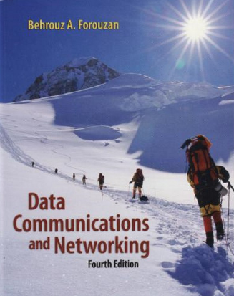
Textbooks
 | Degrees
20 | Midterm
10 | Quiz’s
10 | sec
10 | Others

Slide 5
Chapter 1

Slide 6
Data and Computer Communications
Data Communications
Networking
Protocols
Computer communication: the exchange of information (signals)
between 2 or more computers
Computer Network: technology and architecture that allow 2 or more computers are interconnected via a communication network
Protocols: Set of procedures used for communications between entities in different systems

Slide 7
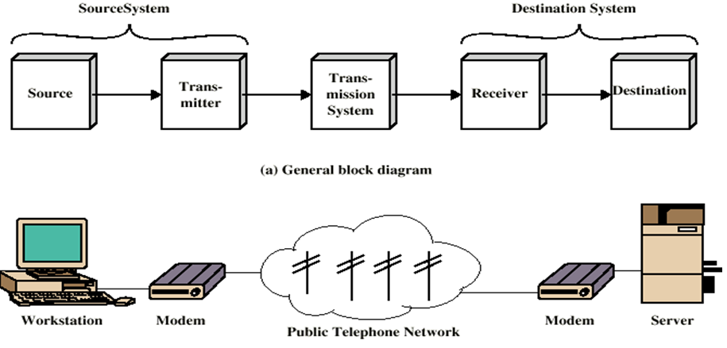
A Communications Model
Source: generates data to be transmitted (telephone, PC)
Transmitter (modems) : Converts data into transmittable signals.
Transmission System: Can be single line or complex network system
Receiver : Converts received signal into data (modems)
Destination : Takes incoming data (telephone, PC)

Slide 8
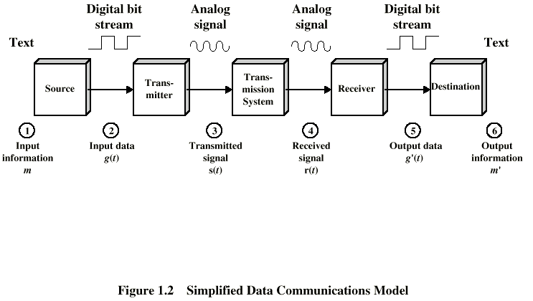
Simplified Data Communications Model

Slide 9
1- Communications Topics (Tasks)
Transmission System Utilization
Interfacing
Signal Generation
Synchronization
Exchange Management
Error detection and correction
Addressing and routing
Recovery
Message formatting
Security
Network Management

Slide 10
Transmission Mode
Simplex
Unidirectional
As one-way street
Half-duplex
Transmit and receive are possible, but not at the same time
Like a one-lane road with two-directional traffic
Simplex
Half-Duplex
Full-Duplex
Full-duplex
Transmit and receive simultaneously
Like a two-way street, telephone network
Channel capacity must be divided between two directions

Slide 11
2- Network
Network: A set of computers and equipments (nodes) connected by communication links
Enterprise Network : 2 or more LANs connected to each other or one LAN connected to WAN
File Server: a computer that contain files shared by PCs on a network
Intranet: a private version of the internet
Characteristics differentiate one Network from another
Topology: the geometric arrangement of devices on the
network.
Protocols: the rules and encoding specifications for
sending and receiving Data
Media: Devices can be connected by coaxial cables, fiber optics or wireless via radio waves
Medium Access control: schema allow sharing of the media

Slide 12
Criteria of Efficient network System
performance
Reliability
Response time For 1- transmission
2- Data processing
Throughput
Amount of work performed by system / time
Measure of system Failure (mean time between failure)
Fault- tolerance solution
Design - Duplication
Flexibility
Growth change is available with minimum impact on users
Legacy system
Standard help
Consistency
Same thing all time
Response time

Slide 13
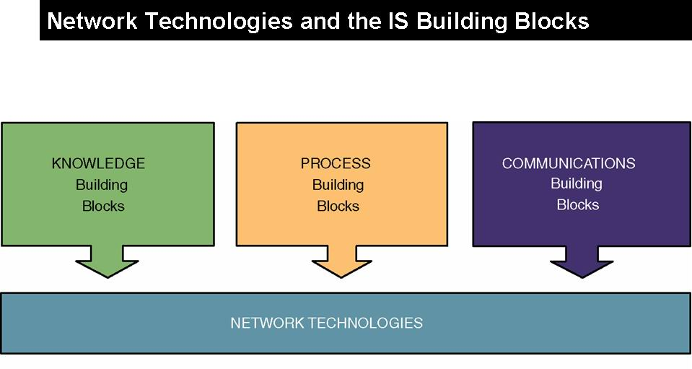

Slide 14
Network Essentials
Technologies
Models
Physical
Topologies
Types
LAN
MAN
WAN
Intranet
internet
Client/server
Peer-to-peer
- Ethernet
Token ring
Transmission control
Protocol/internet
Protocol TCP/IP
Wireless application
Bus
Ring
Star

Slide 15
Network Line configuration
Point-to-point
Dedicated link between two devices
The entire capacity of the channel is reserved
Examples: Microwave link, TV remote control
Multipoint
More than two devices share a single link
Capacity of the channel is either
shared: Devices can use the link simultaneously
Timeshare: Users take turns

Slide 16
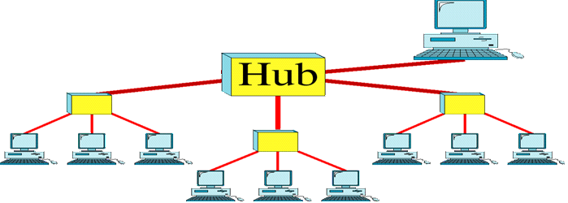
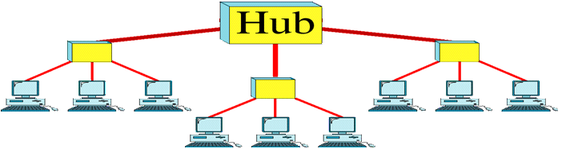
Network Models
Client/server Model:
Microcomputer users or
clients share services of
a centralized computer
called server
server
Peer-to-peer
Computers share equally with one another without having to rely on a central server

Slide 17
Physical Topology
The topology of a network is the geometric representation of the relationship of all the links and linking devices (nodes) to one another.
There are four basic topologies : mesh, star, bus, and ring
1- Mesh Topology
Every device has a dedicated link to every other device.
Number of physical links in mesh with n nodes. Each connected to n – 1 nodes = n(n - 1) physical links
if each physical link allows communication in both directions (duplex mode) the number of links by 2. so, we need n(n -1) /2

Slide 18
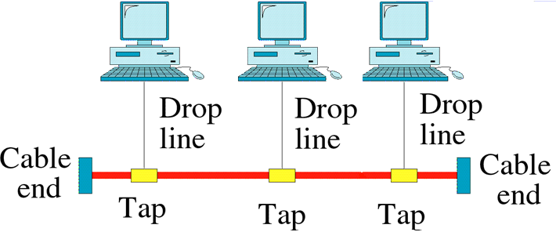
3- Bus Topology
2- star Topology
Each device needs only one link and one I/O port to connect it to any number of others. This factor also makes it easy to install and reconfigure.
Nodes connected to the bus cable by drop lines and taps.
Advantages of a bus topology: ease of installation.
Disadvantages :difficult reconnection

Slide 19

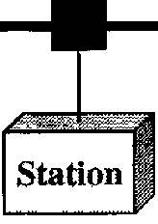
4- ring Topology
Each device has dedicated point-to - point connection with only the two devices on either side of it.
signal is passed along the ring in one direction until reaches its destination.
Each device in ring incorporates a repeater. When a device receives a signal intended for another device, its repeater regenerates the bits and passes them
Repeater
Repeater
4- Tree Topology

Slide 20

Types of Networks
1- Local Area Networks
Building or small campus
from 10m up to 1 km
Data rates much higher
Usually broadcast systems
Now some switched systems and ATM are being introduced

Slide 21
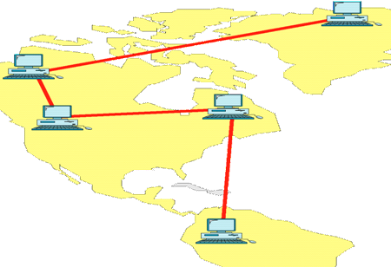
2- Man : It is suitable for
Large geographical area
Crossing public rights of way
Up to 10km (city)
3-WAN
-from 100 km up to 1000km

Slide 22
Internetwork (Internet)
up to 10000km

Slide 23
Assume we need to download text documents at the rate of 100 pages per minute. What is the required bit rate of the channel?
Solution
A page is an average of 24 lines with 80 characters in each line. If we assume that one character requires 8 bits, the bit rate is

Slide 24
L3: Switching Networks for WAN
Circuit–switching
Network
Packet- switching
Network
Message-witched
Network
Datagram Network
Virtual-circuit
Networks

Slide 25
Circuit Switching
Made of a set of switches connected by physical links, in which each link is divided into n channels
e.g. telephone network
Packet Switching
One link
n channel
No resources reservation, resources are allocated based on demand

Slide 26
Integrated Services Digital Network -ISDN
Narrowband ISDN
use 64 kb/s channel as basic switching unite
used with circuit switching
Broadband ISDN
very high data rate up to 100s Mb/s
used with packet switching
Designed to replace public telecom system
Introduce a Wide variety of services (telephone, video on demand VoD, digital data)
Entirely digital domain

Slide 27
Logical and physical connection
Logical connection: exists only in the software
physical connection: exists in the hardware
Network architecture
One link
n channel
Logical connection:
All higher Layers
physical connection:
exists in the physical Layer only

Slide 28
What are Switched Networks?
Switch: moves bits between links
Packet switching
Circuit switching
Switched Network

Slide 29




Back in the Old Days…

Slide 30
Then Came TDM…
Synchronous time division multiplexing
Multiplex (mux)
Demultiplex (demux)

Slide 31
TDM Logical Network View

Slide 32




Packet Switching (Internet)
Packets

Slide 33
Packet Switching
Interleave packets from different sources
Efficient: resources used on demand
Statistical multiplexing
General
Multiple types of applications
Accommodates bursty traffic
Addition of queues

Slide 34
Statistical Multiplexing Gain
1 Mbps link; users require 0.1 Mbps when transmitting; users active only 10% of the time
Circuit switching: can support 10 users
Packet switching: with 35 users, probability that >=10 are transmitting at the same time < 0.0017
Notes:
1-SUM[from n=0..9 of (35 chose n) * (.1^n) * (1-.1)^(40-n)

Slide 35
Characteristics of Packet Switching
Store and forward
Packets are self contained units
Can use alternate paths – reordering
Contention
Congestion
Delay

Slide 36
Second Step: Internet[work]
A collection of interconnected networks
Host: network endpoints (computer, PDA, light switch, …)
Router: node that connects networks
Internet vs. internet
Internet[work]
Notes:
What if want to communicate between hosts on different Ethernets? Internet as interoperability layer

Slide 37
Challenge
Many differences between networks
Address formats
Performance – bandwidth/latency
Packet size
Loss rate/pattern/handling
Routing
How to translate between various network technologies

Slide 38
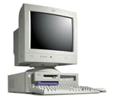
Third Step: How To Find Nodes?
Internet
Computer 1
Computer 2

Slide 39
Naming
Humans use readable host names
E.g. www.cmu.edu
Globally unique (can correspond to multiple hosts)
Naming system translates to physical address
E.g. DNS translates name to IP Address (e.g. 128.2.11.43)
Address reflects location in network

Slide 40
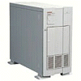
Domain Name System
What’s the IP address for www.cmu.edu?
It is 128.2.11.43
Computer 1
Local DNS Server
DNS server address manually configured into OS

Slide 41
Packet Routing/Delivery
Each network technology has different local delivery methods
Address resolution provides delivery information within network
E.g., ARP maps IP addresses to Ethernet addresses
Local, works only on a particular network
Routing protocol provides path through an internetwork

Slide 42
Network:Address Resolution Protocol
Broadcast: who knows the
Ethernet address for 128.2.11.43?
Ethernet
Unicast: Yes, it is
08-00-2c-19-dc-45
Ethernet

Slide 43
Internetwork: Datagram Routing
Routers send packet to next closest point
H
R
H
H
R
R
R
R
R
H
R
H: Hosts
R: Routers
R
H

Slide 44
Routing
Forwarding tables at each router populated by routing protocols.
Original Internet: manually updated
Routing protocols update tables based on “cost”
Exchange tables with neighbors or everyone
Use neighbor leading to shortest path

Slide 45
Fourth Step: Application Demands
Reliability
Corruption
Lost packets
Flow and congestion control
Fragmentation
In-order delivery
Etc…

Slide 46
What if the Data gets Corrupted?
Problem: Data Corruption
GET index.html
GET windex.html
Internet
Solution: Add a checksum
X
0,9
9
6,7,8
21
4,5
7
1,2,3
6

Slide 47
What if Network is Overloaded?
Problem: Network Overload
Solution: Buffering and Congestion Control
Short bursts: buffer
What if buffer overflows?
Packets dropped
Sender adjusts rate until load = resources
Called “congestion control”

Slide 48
What if the Data gets Lost?
Problem: Lost Data
GET index.html
Internet
Solution: Timeout and Retransmit
GET index.html
GET index.html
Internet
GET index.html

Slide 49
What if the Data Doesn’t Fit?
Problem: Packet size
On Ethernet, max IP packet is 1.5kbytes
Typical web page is 10kbytes
Solution: Fragment data across packets
ml
x.ht
inde
GET
GET index.html

Slide 50
What if the Data is Out of Order?
Problem: Out of Order
ml
inde
x.ht
GET
GET x.htindeml
Solution: Add Sequence Numbers
ml
4
inde
2
x.ht
3
GET
1
GET index.html

Slide 51
Network Functionality Summary
Link
Multiplexing
Routing
Addressing/naming (locating peers)
Reliability
Flow control
Fragmentation
Etc….

Slide 52
SHEET
PAGE 24-25

Slide 53
